Slide 1
Park Junsu
박준수

Slide 2
Daejeon
-No places to visit
Really
-No famous foods to eat
Really
-No touching histories
Really
= ㄵ

Slide 3
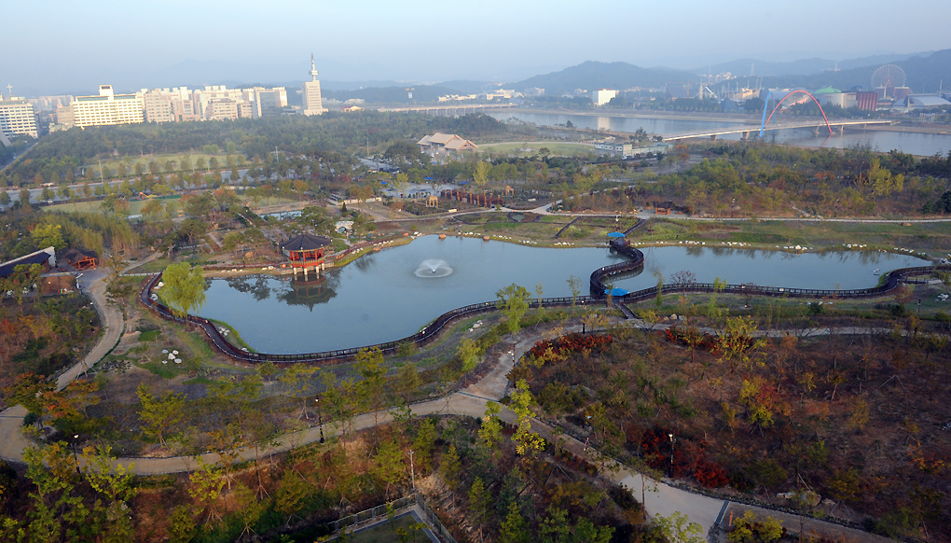
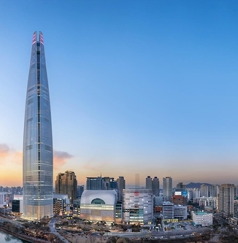
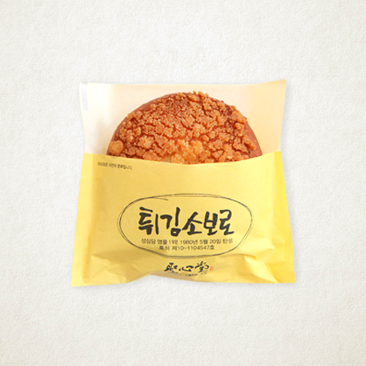
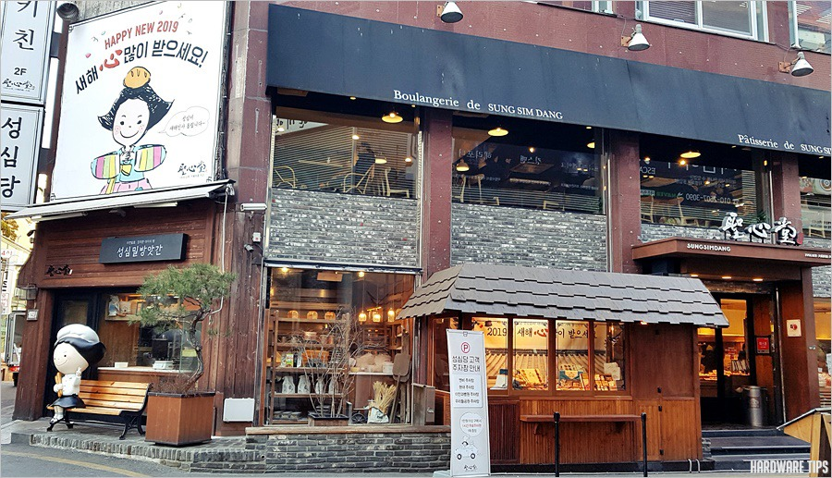
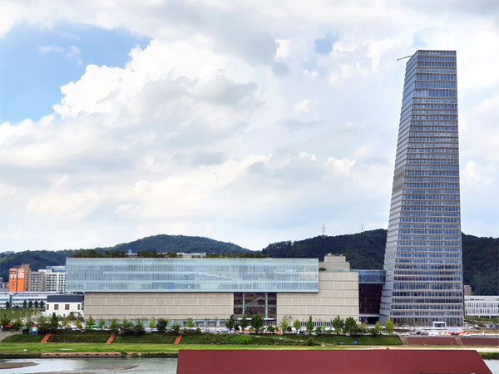
Some places
182-
-Sung Sim Dang (성심당)
Fried Soboro (튀김소보로)
-Shinsegae store
원래 롯데월드!!
서울이 답이다
So high, but normal in other..
162-
-Hanbat Arboretum
Nothing special
EXPO Tower >
= ㄱㄹ
= ㄵ
Shinsegae ds >

Slide 4
Park Junsu
-Handsome
Not Real
-Fun & Cool & Sexy
Not Real
But better president than 162 ㅋ
-Genius
Not Real
= 반장감
= ㄴㅈ

Slide 5
ME
-Sung Si Kyung
Tall and Handsome
-Sung Si Kyung
Sweet Voice and Mind
-Sung Si Kyung
My Role Model
= ㅇㅈ

Slide 6
Ballade
-My favorite genre
Beautiful Melody and Lyrics
-Sung Si Kyung
My Best Ballad Singer
-Emotion
Sad Farewell
= ㅇㅈ

Slide 7
Before
-POP Songs
Only listened to POP songs
-Thinking only about Me
Didn’t care about the other ones
-Sleep, Eat, Play Game
My Life was so useless
-Wls-

Slide 8
Now
-Most Important Time
New Friends, New School, New Life
-Most Precious Time
New Faces, New Mind, New Career
-Most Happy Time
Good Friends, Good Teachers, Good Life

Slide 9
From Now
-Ballad
Forever
-Not thinking only about me
Will care about the other ones
-Sleep, Eat, Study
My Life will be so useful
=ㄹㅇ

Slide 10
땡큐

